Slide 1
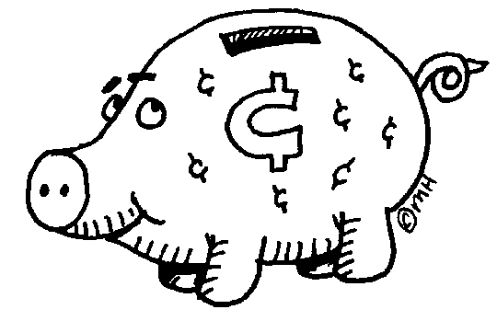
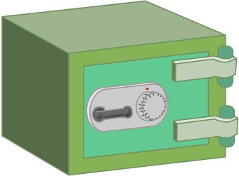
{Name’s} Connections Bank
Directions: Making a connection is one of the best ways to explain an idea! Using the six themes, and the three connections (text-to-text, text-to-self, text-to-world), list possible connections that could be used in future expository essays.

Slide 2
Overcoming Obstacles
Text-to-text
Text-to-world
Text-to-self

Slide 3
Freedom
Text-to-Text
Text-to-World
Text-to-Self

Slide 4
Difficult Choices
Text-to-Text
Text-to-World
Text-to-Self

Slide 5
Faith
Text-to-Text
Text-to-World
Text-to-Self

Slide 6
Knowledge
Text-to-Text
Text-to-World
Text-to-Self

Slide 7
Power
Text-to-Text
Text-to-World
Text-to-Self

